Slide 1
Design of a large wind tunnel for risk assessment on-board Oil & Gas platforms
Domenic D’Ambrosio, Roberto Marsilio, Gioacchino Cafiero, Gaetano Iuso | Politecnico di Torino - DIMEAS
Anna Chiara Uggenti, Raffaella Gerboni | Politecnico di Torino - DENERG

Slide 2
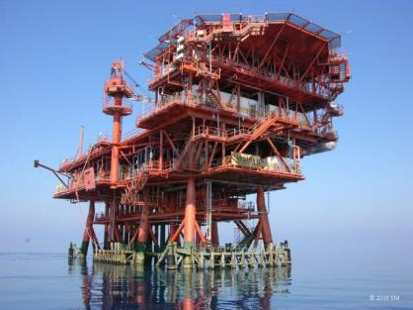
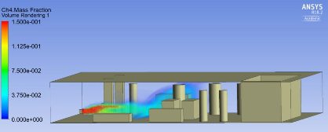
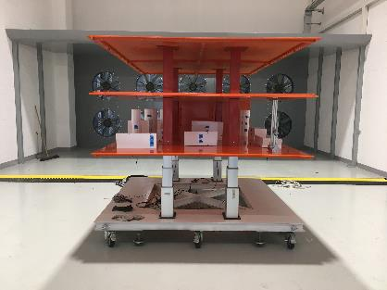
Introduction
Motivation:
need for experimental validation of CFD approaches to risk assessment for supersonic accidental release in Oil & Gas offshore platforms
activity carried out at SEADOG Interdepartmental Center (Safety & Environmental Analysis Division for Oil & Gas)
project funded by the Italian Ministry for Economic Development (MISE), Directorate general for infrastructures and safety of energy and geo-mineral systems – National mining bureau for hydrocarbons and georesources (DGISSEG-UNMIG)
scaling procedures require a sufficiently large offshore platform mockup:
experiments using a 1:10 scaled offshore platform mockup can provide significant results for validation
mockup dimensions about 3x3x3 m -> large wind tunnel

Slide 3
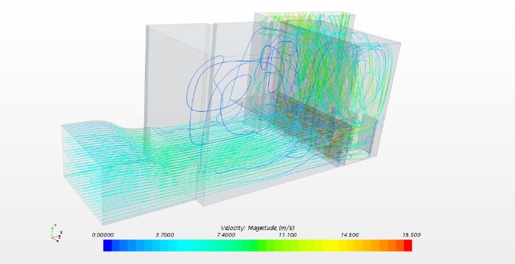
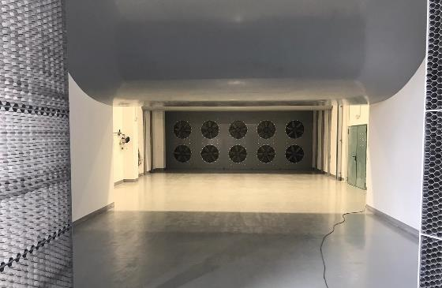
Purpose of the paper
We describe design and characteristics of SEASTAR, a large open-circuit and open-jet wind tunnel
The facility is based in Turin, in the premises of the Environment Park, a public joint-stock company that is an innovation accelerator for businesses looking to use eco-efficient solutions to expand their markets

Slide 4
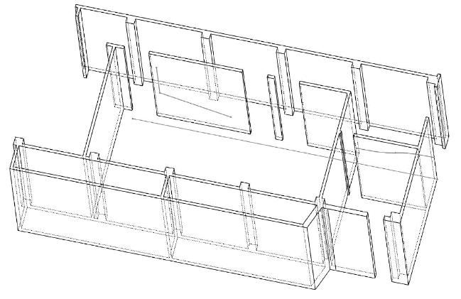
A wind tunnel design subject to some constraints…
The SEASTAR wind tunnel design was carried out by members of the Fluid Dynamics Group of the Department of Mechanical and Aerospace Engineering (DIMEAS) of the Politecnico di Torino
The wind tunnel is in a large room inside a building in the Environment Park complex
due to the requirement of a large test section, an open-circuit design solution was decided, that is the wind tunnel is open on both ends
unfortunately, only one end of the room confines with an almost free, open space, so we decided to use the ceiling of a shaft that runs along one side on the room as the exit section
this was a major constraint that could result in a criticality as it would break the symmetry of the wind tunnel
other rooms
outflow
inflow
shaft
(almost) open area

Slide 5
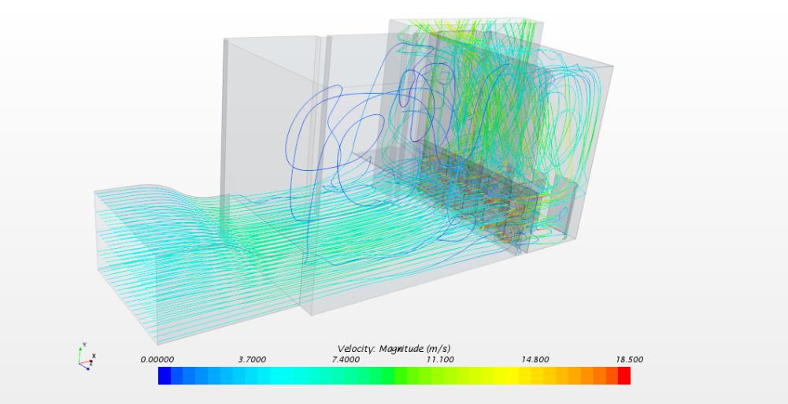
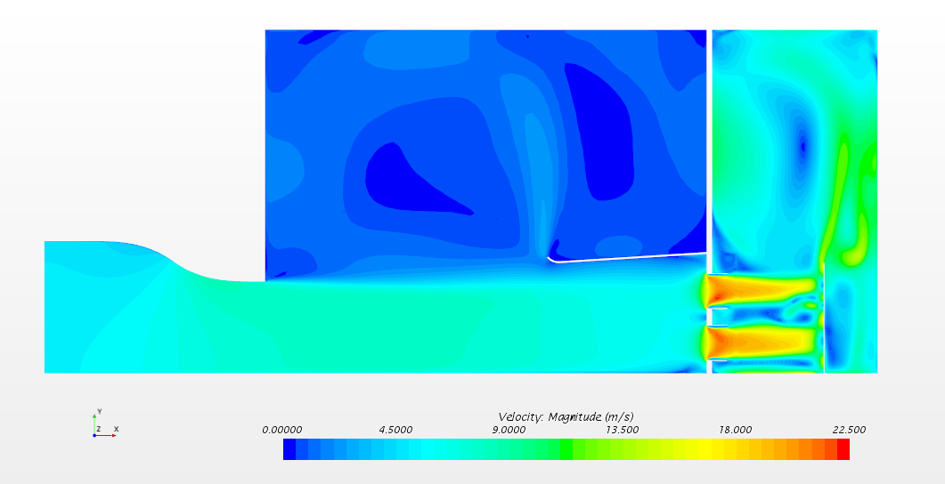
Wind tunnel elements
the SEASTAR facility is an open-circuit, open-jet, rectangular section wind tunnel
as in any wind tunnel, the basic parts are
the settling section, the contraction, the test section, the diffuser, the drive section (equipped with ten fans)
in this case, the flow exit path had to be considered also
outlet
outlet
contraction
diffuser
Open-jet test section
fans
inlet
inlet

Slide 6
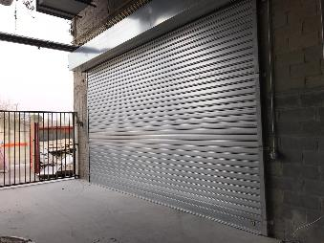
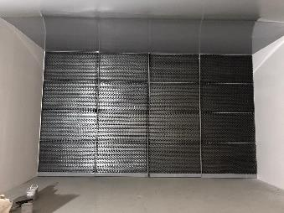
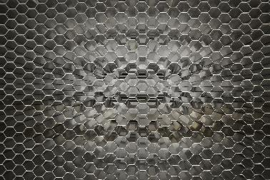
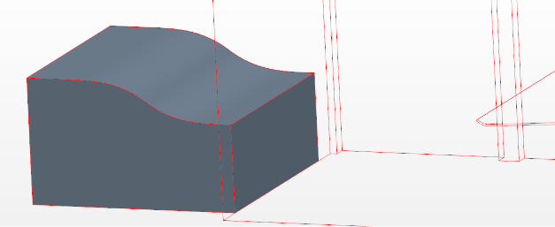
Inlet, settling section and contraction
the air flow
is taken from an almost free space outside the building
is straightened out and its turbulence level is reduced in
a settling chamber equipped with a honeycomb-shaped mesh
is accelerated in a contraction channel
the intake section dimensions are (6.4x3.6) m
the contraction top side is shaped using two cubic curves, the contraction ratio is 1.44
the dimensions of the contraction exit section are (6.4x2.5) m. This are the free-jet test section dimensions also.
inlet
Honeycomb-shaped mesh

Slide 7
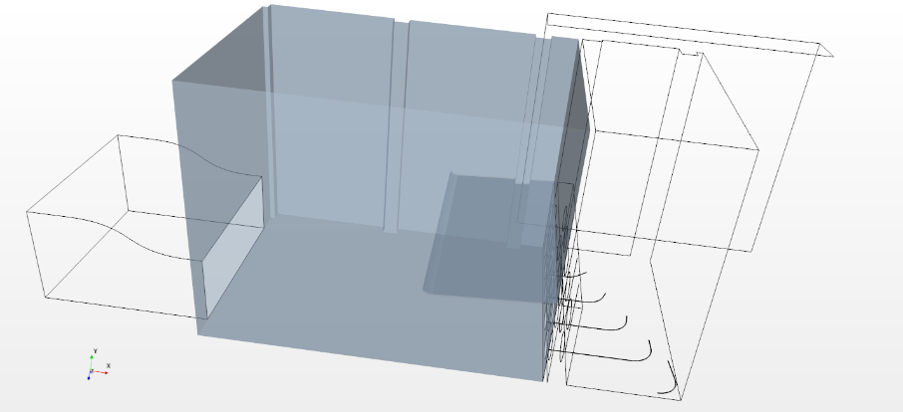
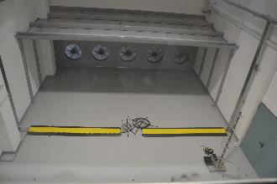
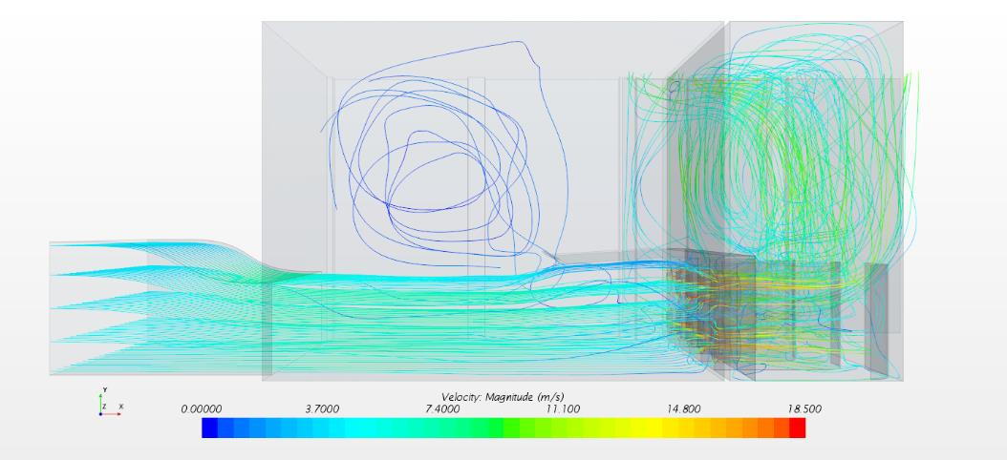
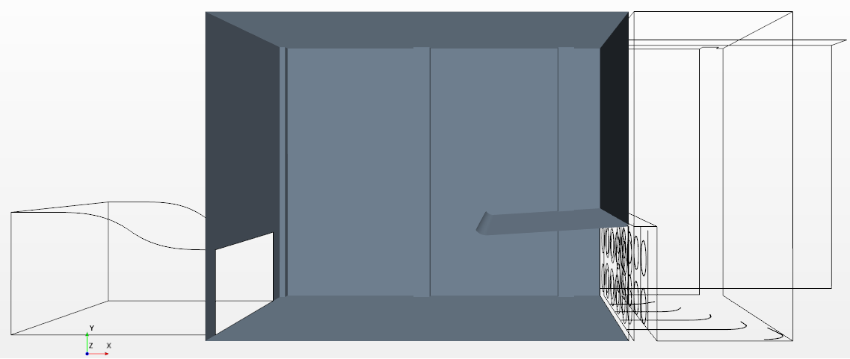
Test section and diffuser
The test section is 7.5 meters long
according to our CFD simulations, a volume of sufficiently uniform flow with dimensions (6x5.5x2.3) m is available (experimental characterization is underway)
The diffuser top side
is a flat diverging ramp with 3.58° angle
is 4 m long, with initial height of 3 m
is as wide as the room, that is 8.5 m

Slide 8
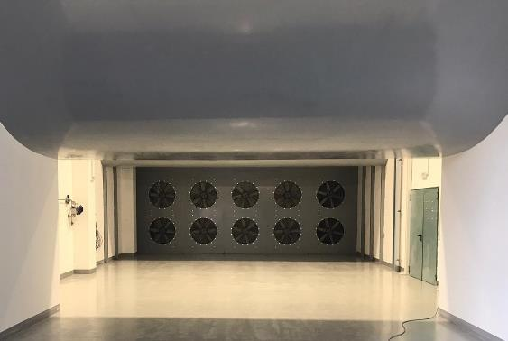
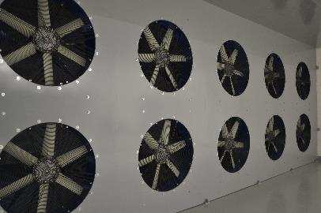
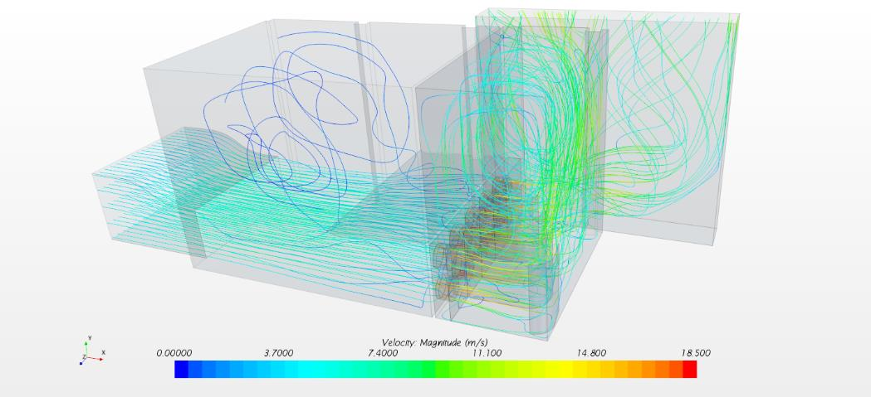
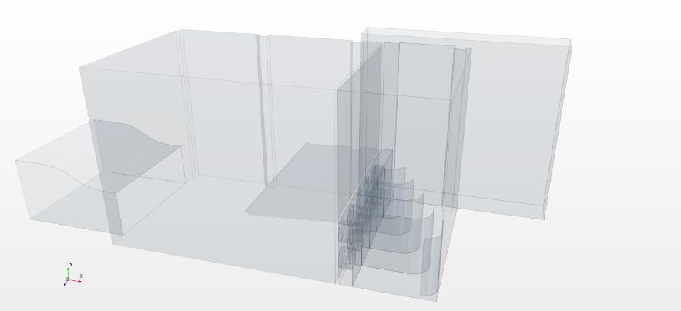
Drive section with fans and air flow exit
The drive section contains 2 rows with 5 fans each
these are electric axial fans with 6 blades
each fan speed can be changed independently
Behind the drive section, the flow recirculates in a large room, enters in the shaft and finally exits in the environment from the open top of the shaft

Slide 9
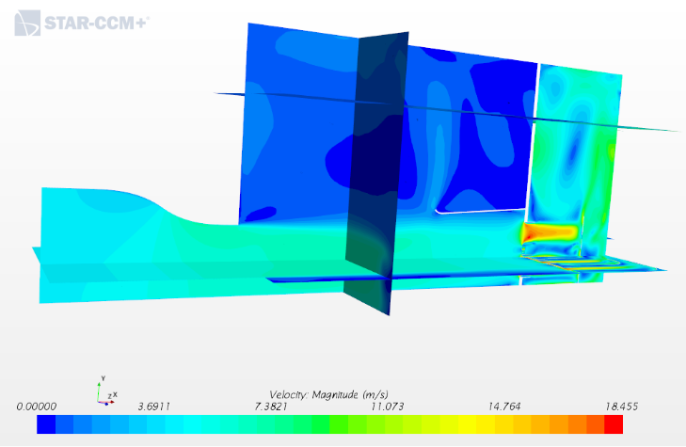
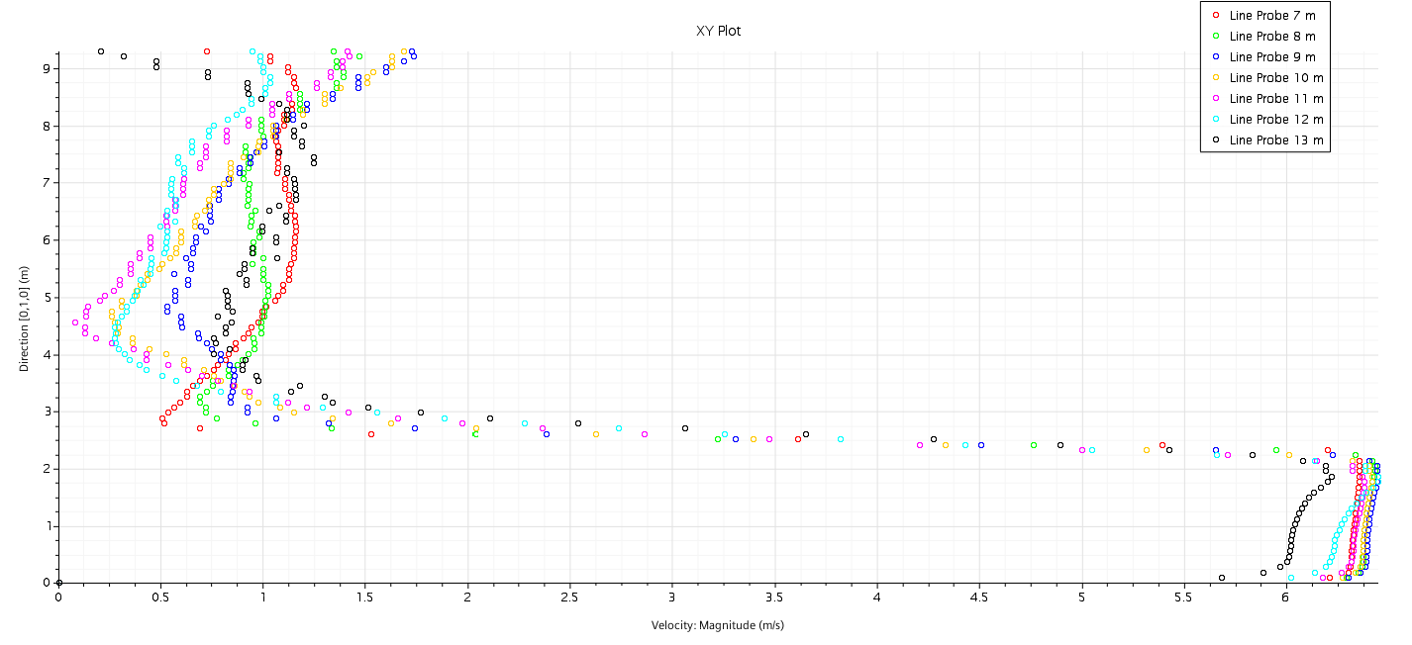
CFD simulations and results
The wind tunnel design was mostly based on CFD simulations using STAR-CCM+
after a grid convergence study, we reached the conclusion that a 3.6 millions cells grid provides sufficient accuracy (note that this is mostly a free flow moving in quite large environment with no small-scale features)
fans where simulated as “fan interfaces” using the pressure/volumetric flow rate curves provided by the fans manufacturer (curves where fitted using polynomial interpolation)
Slow recirculating flow region above the test section jet
Test section free jet, sufficiently uniform until about 1.5 m before the diffuser
2 m

Slide 10
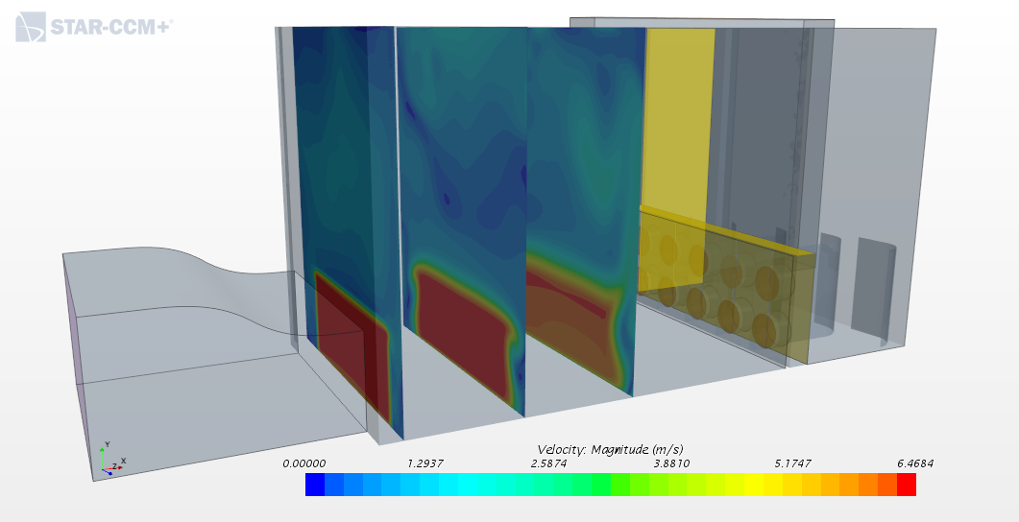
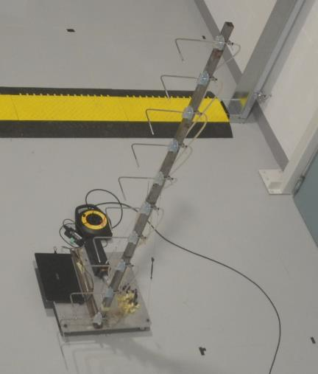
Preliminary calibration results (I)
Preliminary calibration started a few days ago using a Pitot tubes rake that was moved in different positions to obtain a velocity map
Different fan speeds where tested, in particular 30 Hz, 40 Hz and 50 Hz, which correspond to fan rotation speed of 832 rpm, 1136 and 1420 rpm, respectively
calibration sections preliminary positions as seen in CFD simulation
Pitot tubes rake

Slide 11
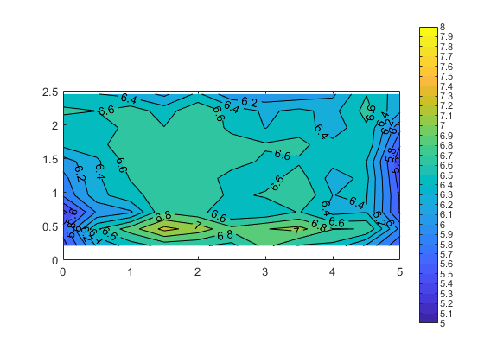
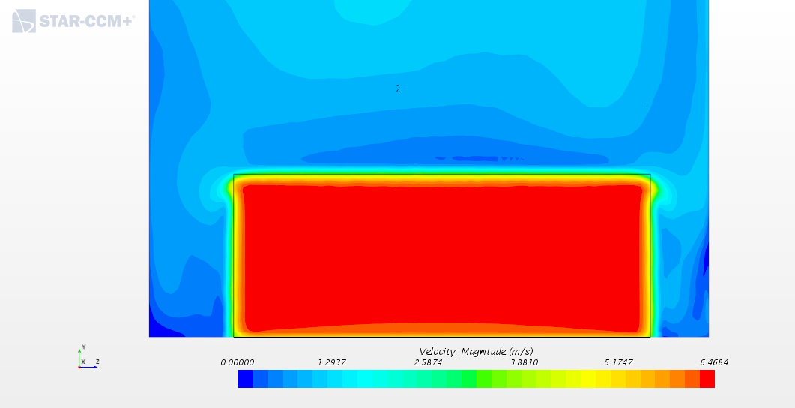
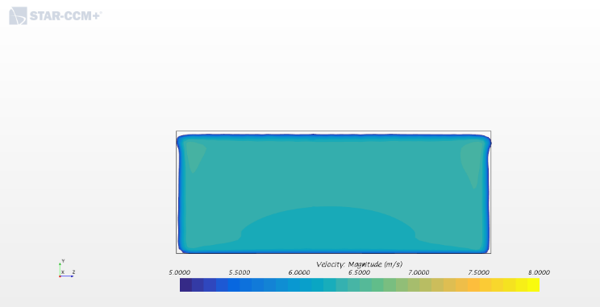
Preliminary calibration results (II)
Here we show a preliminary comparison at 1420 rpm. Section x1 (60 cm after the contraction)
Experimental average speed: 6.48 m/s, with % variation 3.89%.
Numerical maximum speed:6.47 m/s, almost uniform

Slide 12
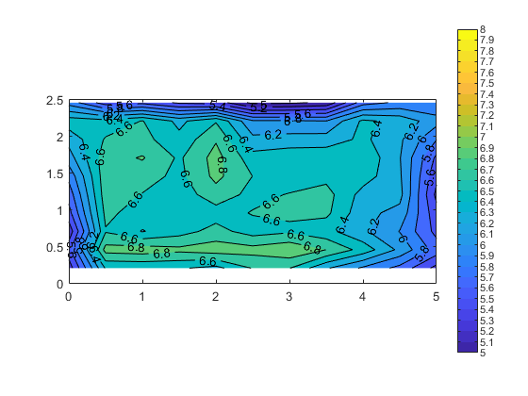
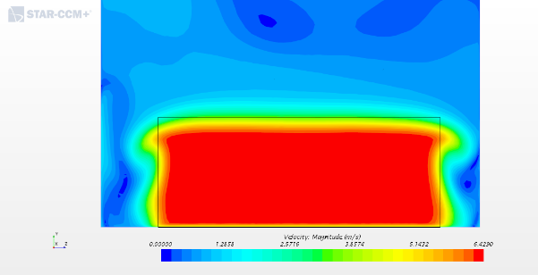
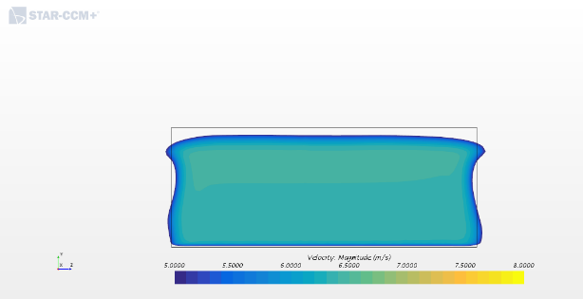
Preliminary calibration results (III)
1420 rpm. Section x2 (3.75 m after the contraction exit)
Experimental average speed: 6.35 m/s, with % variation 5.59%.
Numerical maximum speed:6.43 m/s, almost uniform

Slide 13
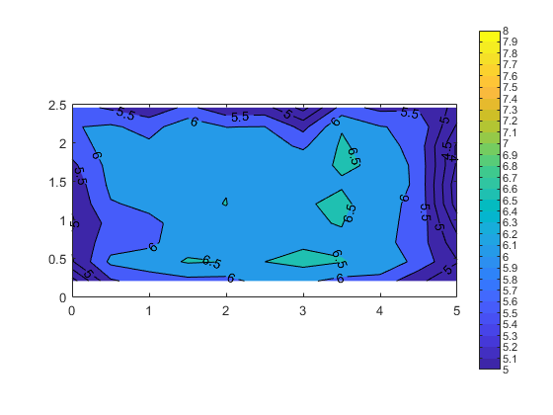
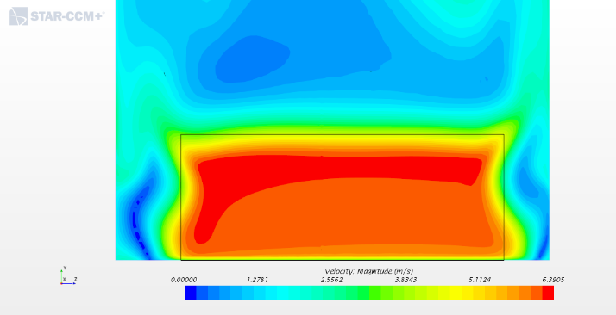
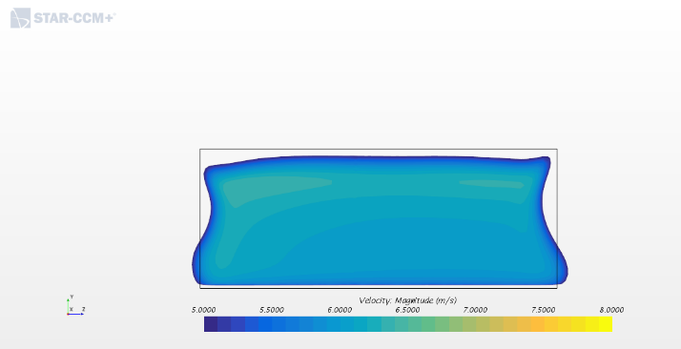
Preliminary calibration results (IV)
1420 rpm. Section x3 (6.90 m after the contraction, close to the diffuser)
Experimental average speed: 6.0 m/s, with % variation 8.42%.
Numerical maximum speed:6.39 m/s, some non-uniformity starts to appear

Slide 14
Conclusions
A new wind tunnel was designed by member of DIMEAS and DENERG at Politecnico di Torino
The wind tunnel is located in the Environment Park in Turin
Large almost uniform free-jet dimensions in the test chamber: 6x5.5x2.3 m
Maximum speed about 7 m/s (about 25 km/h)
Originally designed to test accidental gas releases in Oil & Gas platforms
Can be used in aeronautics (for examples testing aerial drones in wind or advancing conditions), civil engineering (mockups of buildings, bridges, pollutants dispersion/diffusion)
Available for cooperation, may also be rented

